Slide 1
云计算技术
陈果 副教授
湖南大学-信息科学与工程学院-计算机与科学系
邮箱：guochen@hnu.edu.cn
个人主页：1989chenguo.github.io

Slide 2
What we have learned
What is cloud computing
Cloud Networking
Physical Structure
Applications and network traffic
Host networking virtualization
Addressing & Routing
Basic background networking knowledge
Pure layer 2 solution for data center networking (DCN)
VL2 for DCN
Routing basics
ECMP routing
Two multi-path transport scheme
Flowlet & MPTCP

Slide 3
Congestion control
Part I: Cloud networking
Most materials from UIUC MOOC
Ankit Singla
ETH Zürich
P. Brighten Godfrey
UIUC
Credits to

Slide 4
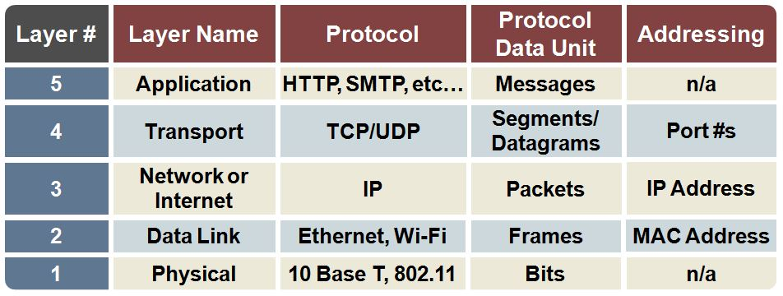
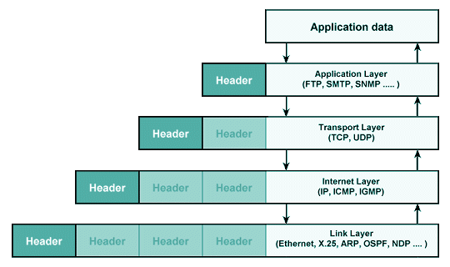
Network layer concepts

Slide 5
Congestion control
Problem: what rate to send at?
Switch
Server-rack
Notes:
In this example scenario …
- servers in rack .. etc.
- some traffic (animate).
- How do we share the link capacity?
- What rate does each sender send traffic at?
- “Why does this matter?”

Slide 6
The right rate is important
Rate > available capacity …
Packet loss and delay
Unfair capacity distribution
Rate < available capacity …
Inefficient use of the network
BUT available capacity is unpredictable!
Notes:
- The right rate is important, because …
- “So what’s hard about this?!”
this is difficult (animate): wide-area? shared? exclusive? wireless?
dynamics complicate things:
bursty traffic
flow inter-arrival times vary: μs to seconds
hundreds of concurrent flows!
“So how do we address the problem?”

Slide 7

Causes/costs of congestion: scenario 2
R/2
idealization: perfect knowledge
sender sends only when router buffers available
λ_{out}
λ_{in}
R/2
λ_{in} : original data
copy
λ'_{in}: original data, plus retransmitted data
λ_{out}
A
free buffer space!
finite shared output link buffers
Host B
From James F. Kurose and Keith W. Ross

Slide 8
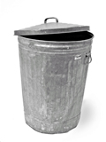
Causes/costs of congestion: scenario 2
Idealization: known loss packets can be lost, dropped at router due to full buffers
sender only resends if packet known to be lost
λ_{in} : original data
copy
λ'_{in}: original data, plus retransmitted data
λ_{out}
A
no buffer space!
Host B
From James F. Kurose and Keith W. Ross

Slide 9
Causes/costs of congestion: scenario 2
Idealization: known loss packets can be lost, dropped at router due to full buffers
sender only resends if packet known to be lost
R/2
when sending at R/2, some packets are retransmissions but asymptotic goodput is still R/2 (why?)
λ_{out}
λ_{in}
R/2
λ_{in} : original data
λ'_{in}: original data, plus retransmitted data
λ_{out}
A
free buffer space!
Host B
From James F. Kurose and Keith W. Ross

Slide 10
Probing the capacity
Notes:
Each sender probes network.
The ACK mechanism (animate) (animate)

Slide 11
Probing the capacity
Notes:
Packet delivered => ACK arrives in one RTT
Or perhaps packet is lost …

Slide 12
Feedback control loop
The network as
a black box
1
Send packets
2
Wait
3
ACKs return in an RTT (or not)
4
Adjust sending rate
Notes:
This sets up a natural feedback loop …
… network as a blackbox (animate) (animate) (animate) (animate)

Slide 13
Basic congestion control idea
All packets ACK-ed …
Increase rate!
Some packets presumed lost …
Decrease rate!
Notes:
“How does the feedback affect the sending rate?”
The basic idea is …
- Note that this way of implementing c.c. …
- switches directly signal congestion

Slide 14
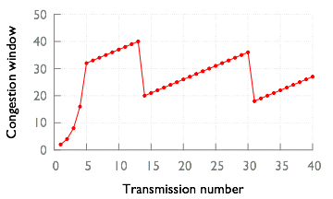
TCP (extremely briefly)
Additive increase
Sending rate
Multiplicative
decrease
Slow-start
Transmission number
Notes:
Skip details here; focus on what changes for the cloud
Linked resources on course Web site
Familiar graph, although details vary
x-axis: iteration of feedback loop; y-axis: sending rate
TCP attempts to match rate to available capacity
slow start (animate)
threshold (animate) additive increase
loss: multiplicative decrease (animate)
- not shown here: timeout; hundreds of milliseconds
So far, … review.
Now, problems with TCP
some apply broadly
some specific to or exacerbated by the cloud

Slide 15
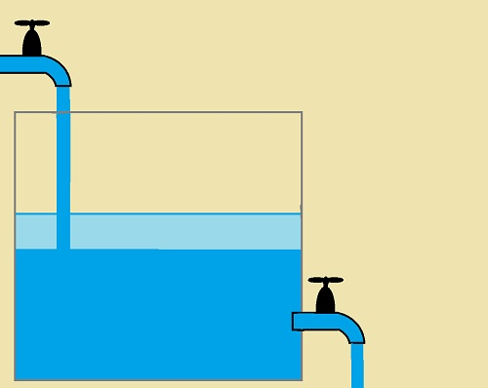
Congestion control analogy

Slide 16
Problems with TCP
Additive increase
Congestion window
Sending rate
Multiplicative
decrease
Slow-start
Transmission number
Notes:
- First, multiplicative decrease can be too aggressive.
- Perhaps rate only marginally larger
- drastic reduction is unnecessary, inefficient

Slide 17
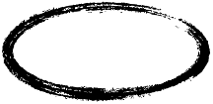
Problems with TCP
Additive increase
Reacting to
losses
Congestion window
Sending rate
Multiplicative
decrease
Slow-start
Transmission number
Notes:
Second, loss can be a poor signal of congestion
Loss caused by transient conditions?
- Further, waiting for losses => long queues

Slide 18
Long queues ⇒ queueing delays
Buffer
Notes:
Let’s look back at our example scenario …
- zoom in on this buffer …
- the buffer fills up (animate)
- increase latency!
“In fact, in data centers, queuing latency dominates! This point is worth emphasizing. To borrow from Rear Admiral ‘Amazing’ Grace Hopper … ”

Slide 19
Scatter-gather traffic pattern
Web search query
Result aggregator
…
Search index
server
Notes:
Certain application patterns exacerbate such problems.
Web search with its scatter-gather pattern
… aggregator queries search indexes …

Slide 20
Scatter-gather traffic pattern
Search response
…
Notes:
… waits for their responses
low latency is crucial! User experience AND bottom line
- But such traffic patterns build long queues, increase the latencies
- Can also cause a more severe condition: incast

Slide 21
TCP Incast
Buffer
Aggregator
Notes:
With a large number of flows competing for the same link … (animate)
The buffer may be overwhelmed and drop a large number of packets.
If many flows suffer TCP timeouts …
- Setting a lower timeout period helps, but does not go far enough — still increase latency because of full buffers …

Slide 22
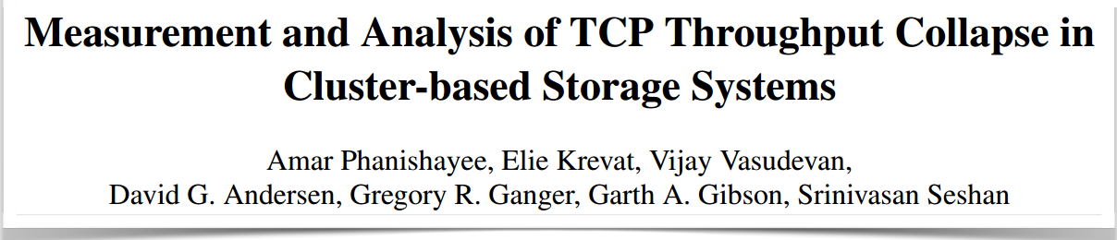
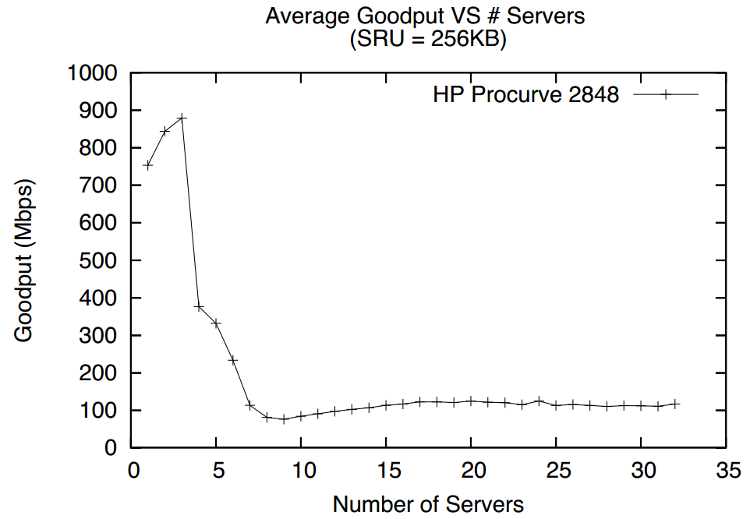
TCP Incast
USENIX FAST, 2008
Notes:
Incast has been measured in both the laboratory and in deployment.
One such measurement for synchronized reads on a storage cluster.
(describe plot)

Slide 23
How do we address
these problems?
Notes:
We’ve seen … (recap)
Next time … (how these problems can be solved)

Slide 24
Two goals in conflict?
1
High throughput: buffers absorb bursts
2
Low latency: large, full buffers cause delays
Notes:
It may seem that we’re pursuing two conflicting goals:
large buffers to absorb traffic bursts
but large, full buffers cause high latency
- High throughput and low latency: fundamentally at odds?
Not a cloud-specific problem, BUT
cloud setting exacerbates it:
(a) queuing delay dominates
(b) the need for performance isolation
(c) application patterns that cause incast
Next, we’ll look at one solution … Data center TCP (DCTCP)

Slide 25
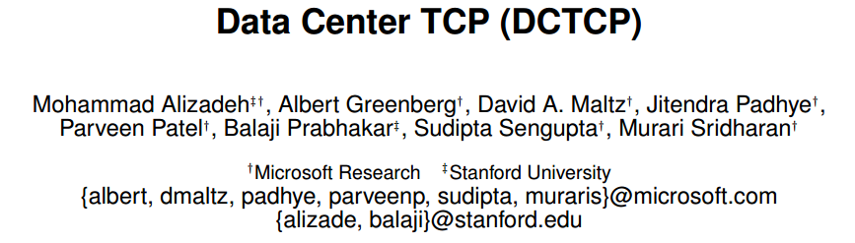
Data Center TCP (DCTCP)
ACM SIGCOMM, 2010
First published in 2010, in use today!
Notes:
This discussion will largely be based on …
- Alizadeh et al., 2010
- now being used
One key observation:
- waiting until the buffer is full is too late
Idea comes from ECN mechanism

Slide 26
Explicit Congestion Notification (ECN)
High threshold
Low threshold
Notes:
If a packet arrives at an ECN-enabled switch facing congestion (animate)
the switch marks … (animate)
Receiver copies mark to ACK
the sender then takes the same actions as on a drop
BUT before buffer is full!
Briefly, here’s how ECN marking works: switch monitors average queue size..
(high threshold) (animate)
(low threshold) (animate)

Slide 27
DCTCP: simple congestion marking
Marking threshold
Notes:
With DCTCP switch operation is even simpler.
It depends only on instantaneous queue size
This makes reactions to changes in conditions faster.

Slide 28
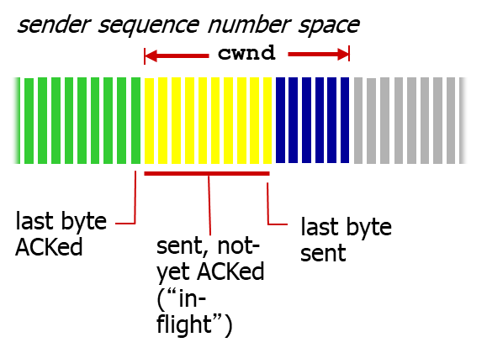
DCTCP: sender reaction to congestion
33% ACKs marked:
reduce rate proportionally!
ACK stream
at sender
Adjustable parameter
Marking ratio
Notes:
But DCTCP’s most valuable insight …
sender’s reaction to congestion markings
estimate the extent of congestion
Instead of using it as a binary indicator
apart from keeping buffer occupancy low, solves a key problems
multiplicative decrease being too aggressive
Sender maintains a running average of fraction of marked packet
Adjustment to sending rate is proportional
To summarize what DCTCP does:
Switches: mark packets with congestion bits
Senders: estimate extent of congestion; react proportionally
The marking threshold can be set low => low latency
The free room in the buffer => absorb bursts
Reduction in losses => fewer timeouts => incast is prevented

Slide 29
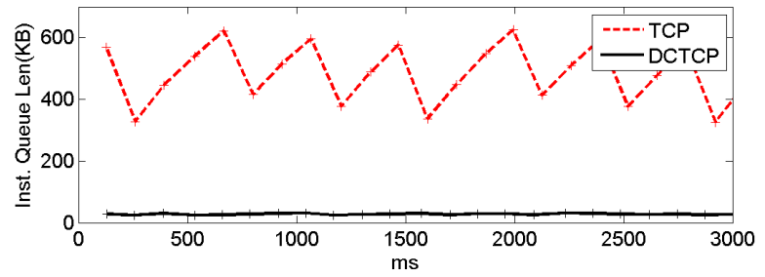
DCTCP control congestion better

Slide 30
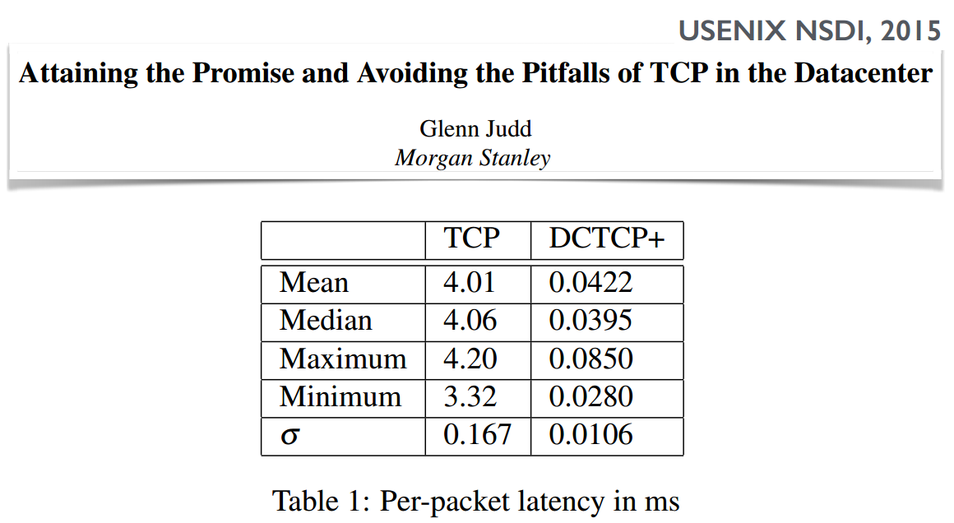
DCTCP result
Two orders of magnitude lower latency!
Notes:
Real deployment experiments
… two orders of magnitude lower latency
Important note: one problem that DCTCP addresses
… TCP’s aggressive reaction to the loss of a packet.
… DCTCP not the first
… RCP … years earlier with a different mechanism

Slide 31

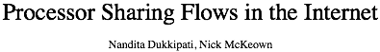
DCTCP, RCP, and deployability
Set rate
explicitly
IEEE IWQoS, 2005
Notes:
RCP:
explicitly share rate equally among flows (animate)
set it in a packet header field
receiver copies it into ACK
sender uses the explicit rate
added advantage: no slow start
Two big reasons that favored DCTCP’s deployment:
DCTCP’s dependence on only existing hardware
the cloud environment
The ambitious RCP proposal, titled “Processor sharing flows in the Internet”, didn’t have the same opportunity.
Whilst a success story, DCTCP does have some drawbacks.

Slide 32
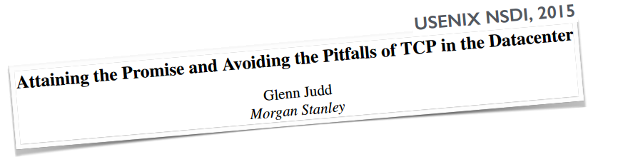
Problems with DCTCP
1
DCTCP is not TCP friendly
2
DCTCP does nothing to get rid of slow start
Notes:
- DCTCP is not TCP friendly
- This problem (and its resolution), in a recent paper (animate)
Doesn’t address slow-start
Applications like RDMA care about …
Slow-start: several RTTs to transfer 10s of kilobytes
Getting rid of slow-start: also active area of research.
Opportunities for doing even better:
- application behavior
- prioritization
TCP-way not the only design possibility
Centralized controller set end-host rates
Active research … limited in how deeply controller manages flows
That wraps up our segment on congestion control
For those interested in more details, we have linked resources …

Slide 33

Let’s see some cooler works

Slide 34
Enhancing Data Center Networking
Enhancing DCN with multi-path transport
Multi-path transport loss recovery [USENIX ATC 2016]
Multi-path transport for RDMA [NSDI 2018]

Slide 35
Enhancing Data Center Networking
Enhancing DCN with multi-path transport
Multi-path transport loss recovery [USENIX ATC 2016]
Multi-path transport for RDMA [NSDI 2018]
Fast and Cautious: Leveraging Multi-path Diversity for Transport Loss Recovery in Data Centers Guo Chen, Yuanwei Lu, Yuan Meng, Bojie Li, Kun Tan, Dan Pei, Peng Cheng, Layong (Larry) Luo, Yongqiang Xiong, Xiaoliang Wang and Youjian Zhao

Slide 36
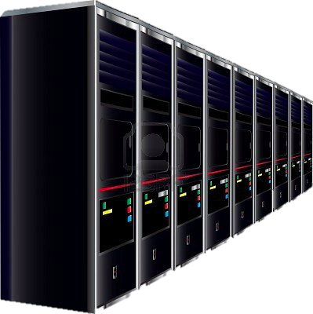

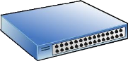




Background
App.
Logic
Large-scale Web Application
App
Logic
App
Logic
App
Logic
App
Logic
App
Logic
App
Logic
App
Logic
App
Logic
App
Logic
App
Logic
App
Logic
Data Structures
Alice
Applications
App Tier
Possibly 1000s of flows per operation
Every microsecond matters
Tail latency matters
(e.g., 99.9th percentile)
Flow completion time
Fabric
Data Tier
Eric
Minnie
Pics
Apps
Videos
Data Center

Slide 37
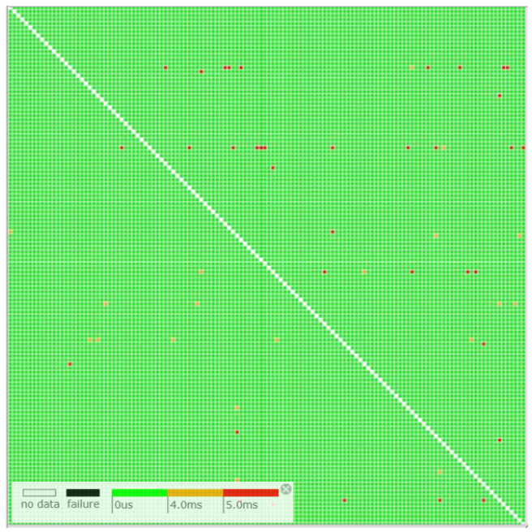
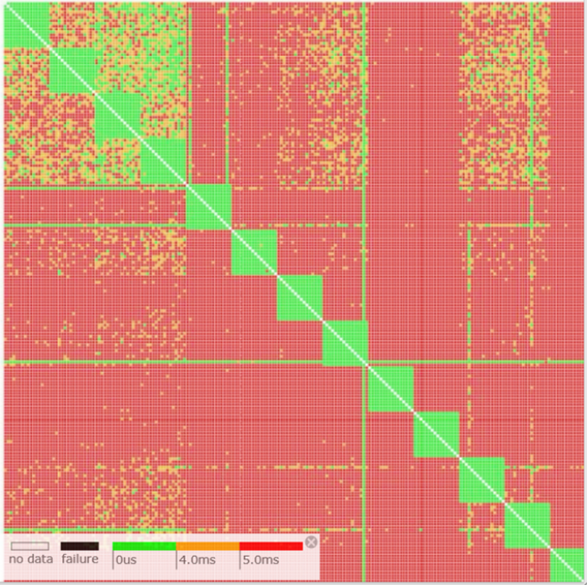
Motivation
Services care about the tail flow completion time (FCT)
Large number of flows generated in each operation
Overall performance governed by the last completed flows
But packet loss hurts tail FCT
Real case in a Microsoft Azure’s DCN
Spine switch 2% random drop rate -->
increase of 99th percentile latency of all users
DCN tail latency visualization
[Pingmesh (SIGCOMM’15)]
(a) Normal
(b) Spine failure
Notes:
However, packet loss hurts the tail FCT very much. A real case once happened in a Microsoft production data center can be a good example to show this problem. A spine switch with 2% random drop rate led to dramatic increase of 99th percentile latency of all users in this DCN.
Unluckily, packet loss is not uncommon even in well-engineered DCN.
This work is to address the tail FCT problem caused by packet loss in DCN.

Slide 38
Outline
Motivation
Packet Loss in DCN
Impact of Packet Loss
Challenge for Loss Recovery
FUSO Design
Evaluation
Summary

Slide 39
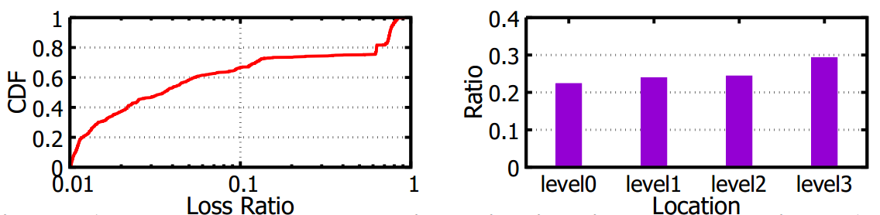
Packet Loss in DCN
Loss characteristics
Measured in a Microsoft production DCN during Dec. 1st-5th, 2015
78% above ToR
Mean loss rate 4%
Similar in 5 days
Loss rate and location distribution of lossy links (loss rate > 1%)
Loss frequently happens (the overall loss rate is low)
Most losses happen in the network instead of the edge
Notes:
First, we measure the attributes of packet loss in a Microsoft production DCN for five days.
We have two observations:
Although the overall loss rate in the network is low, loss happens frequently. Many high loss rate links appear during all the 5 days.
Most losses happen in the network instead of the edge. ~80% lossy links are located above the ToR switches.

Slide 40
Packet Loss in DCN
Reasons causing loss
Congestion loss
Uneven load-balance
Incast
Failure loss
Silent random drop
Packet black-hole
Bursty; Transient
Greatly mitigated
(e.g., 1%->0.01%)
[Jupiter Rising SIGCOMM’15]
Complex; Hard to detect
Common
& Huge impact on performance
[Pingmesh SIGCOMM’15]
Notes:
There are various reasons that cause packet loss. In high-level, they can be classified as two types.
Conventionally, most of packet losses are due to buffer overflow caused by congestion. Congestion losses are bursty and transient.
With the increasing deployment of the Explicit Congestion Notification and fine-tuned TCP congestion control algorithm, congestion losses have been greatly mitigate. But they are still inevitable.
Besides congestion, failure loss is another major source of packet loss, such as silent random drop or packet black-hole. They are caused by complex reasons, and hard to detect.
In large scale networked-systems, failure losses are common, and often have huge impact on performance.

Slide 41
Outline
Motivation
Packet Loss in DCN
Impact of Packet Loss
Why loss hurts the tail?
How hard loss hurts?
Challenge for Loss Recovery
FUSO Design
Evaluation
Summary
Notes:
In order to solve this problem, we first need to understand why loss hurts the tail FCT.

Slide 42
How TCP Handles Loss?
Fast recovery
Wait for certain number of DACKs to detect the loss and retransmit
Timeout (RTO)
If not enough DACKs return, retransmit after a timeout
RTO >> RTT e.g. RTO=5ms, RTT<100us
[Pingmesh (SIGCOMM’15), DCTCP (SIGCOMM’10)]
Encountering one RTO →
dramatically increase the FCT
Notes:
Once a packet gets lost in the network, TCP as the transport protocol in DCN, needs to recover it to provide reliable communication.
There are two existing loss detection and recovery mechanisms in
TCP:
To prevent from premature timeouts, and also limited by the precision of the timer, RTO is usually orders larger longer than the round-trip-time (RTT). Specifically, in a production datacenter, the minimum RTO is set to be 5ms, while the RTT is usually tens of microseconds.
As a consequence, for a delay sensitive flow, which is usually small in size, encountering merely one RTO would already increase its completion time by several times and cause unacceptable performance degradation.

Slide 43
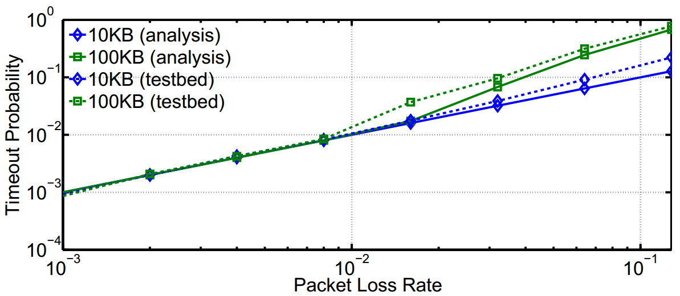
Loss Incurs Timeout
A little loss causes enough timeout to hurt the tail FCT
10KB(analysis)
10KB(testbed)
100KB(testbed)
100KB(analysis)
3% loss → ~10% timeout
99th FCT > RTO
Timeout probability of flows with different sizes passing a path with different packet loss rate
1% loss → more than 1% flows timeout
Larger flows (e.g. 100KB)
timeout ratio sharply grows when loss rate > 1%
To avoid RTO
Notes:
However, unluckily, through both analysis (which analyzes the lower bound) and testbed experiments, we show that in current TCP, a little loss often leads enough RTO to hurt the tail FCT
This figure shows the timeout probability of flows with different sizes under different loss rate.
As we can see, for both flows, a little loss, for example, 1% can lead to more than 1% of the flows timeout, which means 99th FCT > RTO.
And for flows with larger size (100KB), the timeout ratio sharply grows when loss rate > 1%. For example, a 3% loss rate leads to about 10% flows encounter timeout.
We can see that the core issue in achieving low tail FCT for small latency-sensitive flows when facing packet losses
is to avoid RTO.

Slide 44
Outline
Motivation
Packet Loss in DCN
Impact of Packet Loss
Challenge for Loss Recovery
FUSO Design
Evaluation
Summary

Slide 45
Challenge for TCP Loss Recovery
Prior works add aggressiveness to congestion control to do loss recovery before timeout (RTO)
Tail Loss Probe (TLP)
transmit one prober after 2RTT
Instant Recovery (TCP-IR)
generate an FEC packet for every group of packets (up to 16)
FEC packets also act as probers, delayed 1/4RTT before sent
Proactive/RepFlow
Duplicate every packet/flow
[SIGCOMM’13, RFC 5827]
[SIGCOMM’13, RFC 5827]
[SIGCOMM’13, INFOCOM’14]
Notes:
Realizing this problem, to prevent timeout, prior works add aggressiveness to congestion control to do loss recovery before RTO.

Slide 46
Challenge for TCP Loss Recovery
How long to wait before sending recovery packets?
For congestion loss
Should delay enough in case of worsening congestion
Bursty：
Lead to multiple consecutive losses
[Incast (WREN’09), DCTCP (SIGCOMM’10)]
Notes:
However, deciding the aggressiveness level , i.e. , how long to wait before sending recovery packets, to adapt to complex network conditions in DCNs is a daunting task.
As introduced before, congestion and failure loss coexist in DCN. For congestion loss, recovery should be delayed for enough time before being sent out after the original packets.
Congestion loss is very bursty. If a recovery packet is sent too fast before congestion disappears, the recovery packet may get dropped by the overflowed buffer and also worsen the congestion.

Slide 47
Challenge for TCP Loss Recovery
How long to wait before sending recovery packets?
For congestion loss
Should delay enough in case of worsening congestion
For failure loss such as random drop
Should recover as fast as possible, otherwise already increase the FCT
Wait 2RTT is too costly
Accurate & high-precision RTT measurement is challenging
[TLP SIGCOMM’13, RFC 5827]
Notes:
However, for some failure loss such as random drop, recovery packets should be sent as fast as possible to accelerate the recovery process.
Otherwise the delay for sending recovery packets already increases the FCT of latency-sensitive flows.
We see that previous schemes choose different aggressiveness levels in an ad-hoc manner, from 2RTT to immediate duplicate. Unfortunately, the fixed settings of aggressiveness levels make above existing schemes incapable of adapting to complex loss conditions.
Essentially, we identify that the fundamental challenge for transport loss recovery in DCN is how to accelerate loss recovery as soon as possible, under various loss conditions without causing congestion .

Slide 48
Brief Summary
Loss easily incurs timeout to hurt the tail
To prevent timeout, prior works add fixed aggressiveness to recover loss before timeout
Hard to adapt to various loss conditions
Should be fast for failure loss
Should be cautious for congestion loss
How to accelerate loss recovery as soon as possible,
under various loss conditions without causing congestion?
Notes:
However, for some failure loss such as random drop, recovery packets should be sent as fast as possible to accelerate the recovery process.
Otherwise the delay for sending recovery packets already increases the FCT of latency-sensitive flows.
We see that previous schemes choose different aggressiveness levels in an ad-hoc manner, from 2RTT to immediate duplicate. Unfortunately, the fixed settings of aggressiveness levels make above existing schemes incapable of adapting to complex loss conditions.
Essentially, we identify that the fundamental challenge for transport loss recovery in DCN is how to accelerate loss recovery as soon as possible, under various loss conditions without causing congestion .

Slide 49
Outline
Motivation
Packet Loss in DCN
Impact of Packet Loss
Challenge for Loss Recovery
FUSO Design
Evaluation
Summary
Notes:
To this end, we propose FUSO to address this challenge

Slide 50
FUSO: Fast Multi-path Loss Recovery
Utilize the “good” paths to proactively conduct loss recovery for “bad” paths
Leveraging path diversity (multiple paths; a few encounter loss)
Fast and Cautious
Fast
Proactive (immediate) recovery for potential packet loss utilizing spare transmission opportunity
Cautious
Strictly follow congestion control without adding aggressiveness
Notes:
FUSO is short for fast multi-path transport loss recovery.
The idea is to leverage path diversity in DCN, thus to accelerate loss recovery utilizing the “good” paths to proactively conduct loss recovery for “bad” paths.
By path diversity we mean that current DCN provides many parallel paths. Usually, these paths have a big loss diversity due to different congestion and failure conditions. Specifically, when a few paths are experiencing failure, the rest majority paths are in good state without or with few failure losses. Also, caused by uneven load balance [5], some paths may be heavily congested to drop packets while other paths are in light load.
Based on that, FUSO is both fast and cautious.
It is fast in that….
Cautious in that….

Slide 51
Multi-path Transport Background
Sub-flows: Implicitly/Explicitly mapping to physical paths
Sender
Receiver
Data Distribution
SF1
SF1
CWND₁
SF2
SF2
CWND_{total}
CWND₂
SF3
SF3
CWND₃
Multi-path
Congestion Control
Notes:
Before introducing the detailed design of FUSO, I’d like to give some background on multi-path transport.
In multipath transport, a TCP flow is divided into multiple sub-flows.

Slide 52
FUSO
Sender
Receiver
SF1
Lost
SF1
CWND₁
P5
P4
P3
P2
P1
SF2
SF2
CWND_{total}
CWND₂
SF3
SF3
CWND₃
Notes:
想一个简洁的解释为什么三个包去SF3

Slide 53
FUSO
Sender
Receiver
Spare CWND
SF1
Lost
SF1
CWND₁
P2
P5
P4
P3
P1
SF2
SF2
CWND_{total}
CWND₂
No new data
SF3
SF3
CWND₃

Slide 54
FUSO
Proactive loss recovery
Sender
Receiver
SF1
Lost
SF1
CWND₁
P2
P2
P5
P4
P3
P1
SF2
SF2
CWND_{total}
CWND₂
“Worst” sub-flow
P2
SF3
SF3
CWND₃
“Best” sub-flow

Slide 55
FUSO
Proactive loss recovery
Sender
Receiver
SF1
Lost
SF1
CWND₁
P2
P5
P4
P3
P1
SF2
SF2
CWND_{total}
CWND₂
“Worst” sub-flow
P2
SF3
SF3
CWND₃
“Best” sub-flow

Slide 56
Standard MPTCP
Sender
Receiver
SF1
Lost
SF1
CWND₁
Retransmit after an RTO
P2
P5
P4
P3
P1
SF2
SF2
CWND_{total}
CWND₂
SF3
SF3
CWND₃

Slide 57
FUSO: Path Selection
Possibility of encountering loss
Sender
“Worst” Sub-flow
With un-ACKed data
Most likely having loss
SF1
Lost
CWND₁
Un-ACKed data
P2
SF2
CWND_{total}
CWND₂
“Worst” sub-flow
SF3
CWND₃

Slide 58
FUSO: Path Selection
Possibility of encountering loss
Sender
“Worst” Sub-flow
With un-ACKed data
Most likely having loss
SF1
Lost
CWND₁
Spare CWND
P2
SF2
CWND_{total}
CWND₂
“Worst” sub-flow
“Best” Sub-flow
With spare CWND
Least likely having loss
SF3
CWND₃
“Best” sub-flow

Slide 59
FUSO in 1 Slide
If (spare CWND) && (no new data)
Utilize the transmission opportunity to proactively recover
Use “good” paths to help “bad” paths
Multi-path diversity offers many transmission opportunities
“Good” paths have spare window

Slide 60
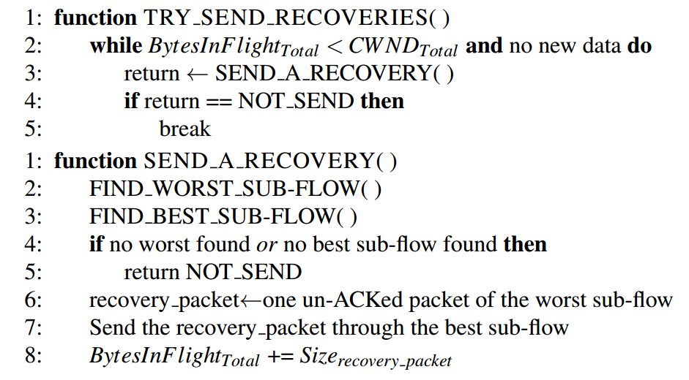
FUSO Implementation
Implemented in Linux kernel; ~900 lines of code
https://github.com/1989chenguo/FUSO

Slide 61
Outline
Motivation
Packet Loss in DCN
Impact of Packet Loss
Challenge for Loss Recovery
FUSO Design
Evaluation
Summary
Notes:
Till now, we have introduced the FMLR design. Next, we use testbed experiments to evaluate its performance.

Slide 62
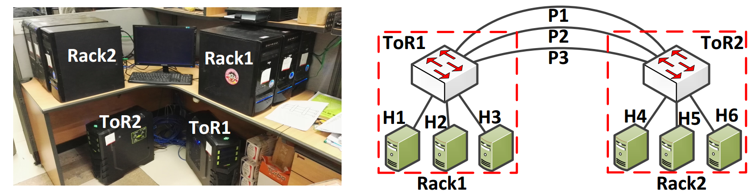
Testbed Settings
Network
1Gbps fabric & 1Gbps hosts; ECMP routing; ECN enabled
TCP
Init_cwnd=16; min_RTO=5ms

Slide 63
Testbed Results
Loss rate:
0.125%-4%
Failure loss
Random-drop
Latency-sensitive
flows
99th FCT
% of flows encountering timeout
Fast
better
Reducing 99th FCT up to ~82.3%
Reducing the timeout flows up to 100%

Slide 64
Testbed Results
Congestion loss
Incast
Concurrent responses
Performs the best
Cautious
better

Slide 65
Testbed Results
Loss rate:
2%
Latency-sensitive flows
Failure loss & Congestion loss
From failure-loss-dominated to congestion-loss-dominated
Background long flows
better
Adapt to various loss condition

Slide 66
Larger-scale Simulations
Simulation settings
NS2 simulator; 3-layer, 4-port FatTree
40Gbps fabric, 10Gbps host; 64 hosts, 20 switches
Empirical failure generation
Random failure
Latency-sensitive flows
Background long flows

Slide 67
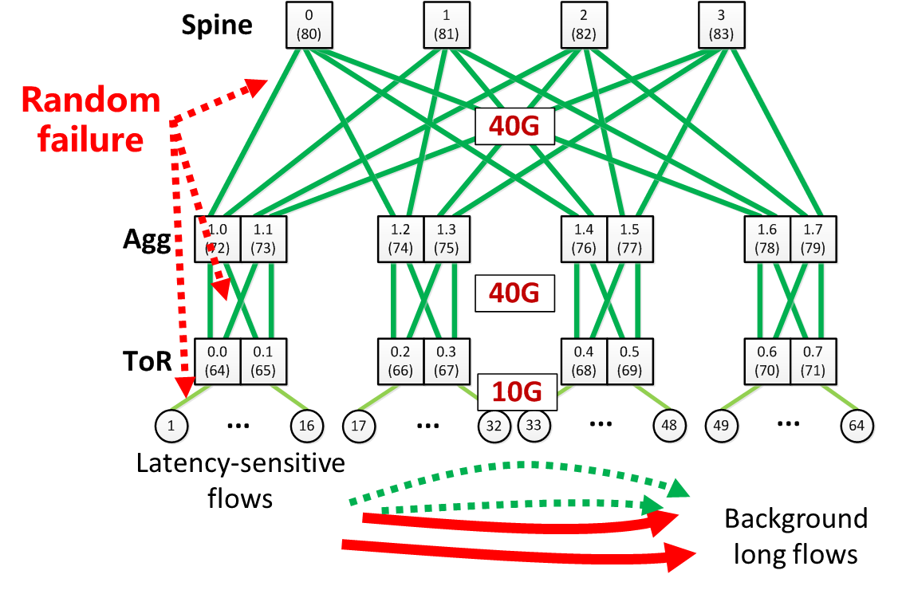
Larger-scale Simulations
Simulation settings
NS2 simulator; 3-layer, 4-port FatTree fabric
40Gbps fabric, 10Gbps host; 64 hosts, 20 switches
Empirical failure generation
better
Reducing the average FCT up to ~60.3%
Reducing the 99th FCT up to ~87.4%

Slide 68
Outline
Motivation
Packet Loss in DCN
Impact of Packet Loss
Challenge for Loss Recovery
FUSO Design
Evaluation
Summary
Notes:
Till now, we have introduced the FMLR design. Next, we use testbed experiments to evaluate its performance.

Slide 69
FUSO Recap
Loss hurts tail latency
Loss is not uncommon
A little loss leads to enough timeout, hurting the tail
Challenges for loss recovery
How to accelerate loss recovery under various loss conditions without causing congestion?
Philosophy for FUSO
To be fast & cautious are equally important
Fast: Proactive loss recovery utilizing spare transmission opportunity, leveraging multipath diversity
Cautious: Strictly follows congestion control without adding aggressiveness
Notes:
RTO--->timeout

Slide 70
Enhancing Data Center Networking
Enhancing DCN with multi-path transport
Multi-path transport loss recovery [USENIX ATC 2016]
Multi-path transport for RDMA [NSDI 2018]
Multi-Path Transport for RDMA in Datacenters
Yuanwei Lu, Guo Chen, Bojie Li, Kun Tan, Yongqiang Xiong, Peng Cheng, Jiansong Zhang, Enhong Chen and Thomas Moscibroda

Slide 71
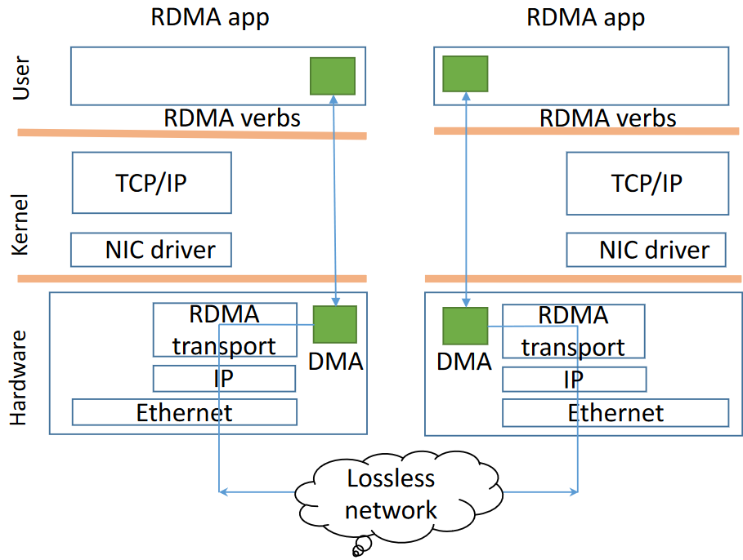
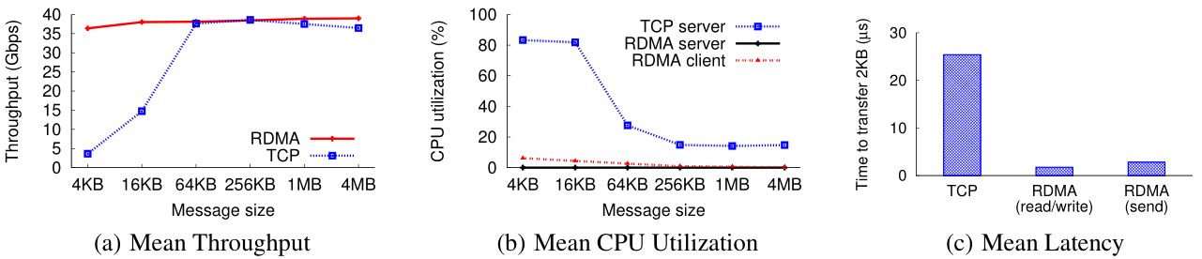
RDMA Background
Remote Direct Memory Access (RDMA)
Bypass kernel; Zero copy
Offload transport to NIC
Super performance
Low and stable latency: < 10us
High throughput: 40/100Gbps
Low CPU overhead

Slide 72
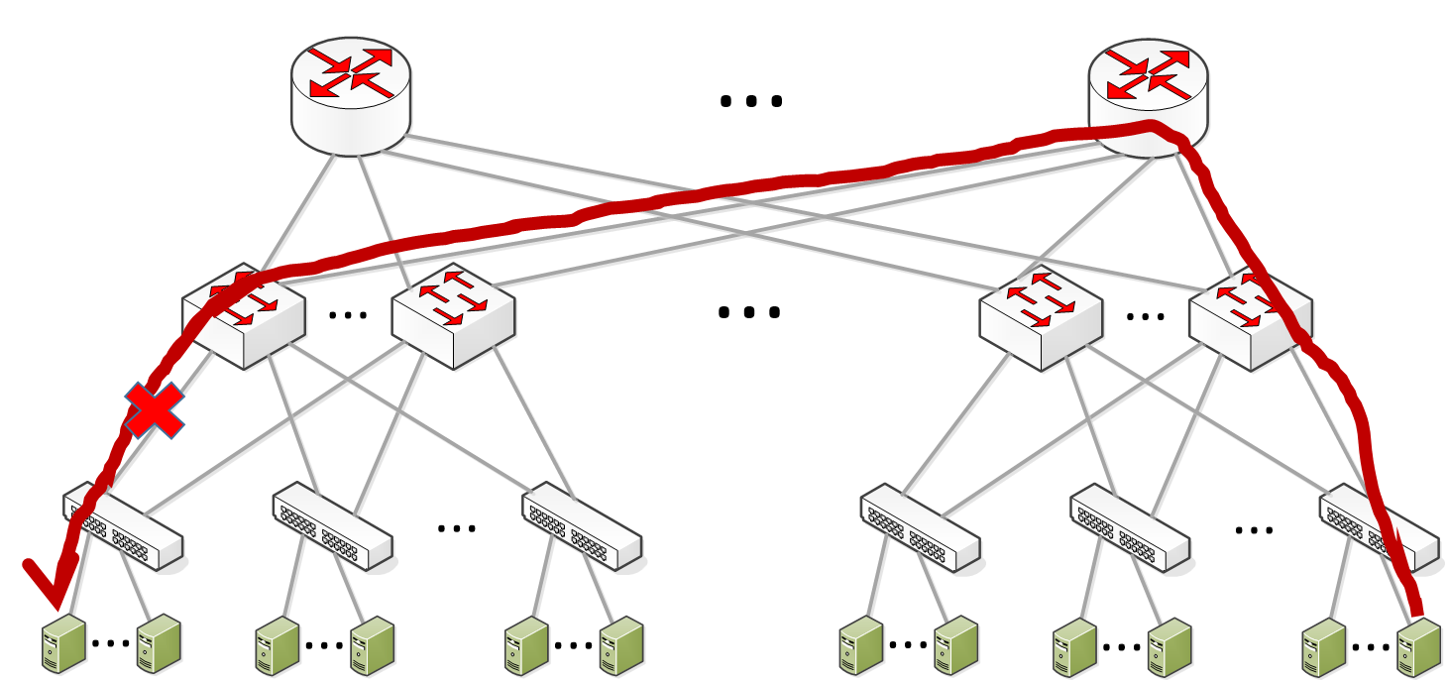
RDMA Background
RDMA (RoCEv2) is deployed at scale in Microsoft Datacenters
e.g. Half of the traffic in a online service datacenter is RDMA [1]
Datacenter topologies: FatTree, Bcube, VL2
Lots of parallel paths between any pair of nodes
Current RDMA uses single-path for transmission
Not robust to failure
Imbalance: low network utilization and hot spot caused high latency
[1] Guo, Chuanxiong, et al. "RDMA over Commodity Ethernet at Scale. "Proceedings of the 2016 conference on ACM SIGCOMM 2016 Conference. ACM, 2016.

Slide 73
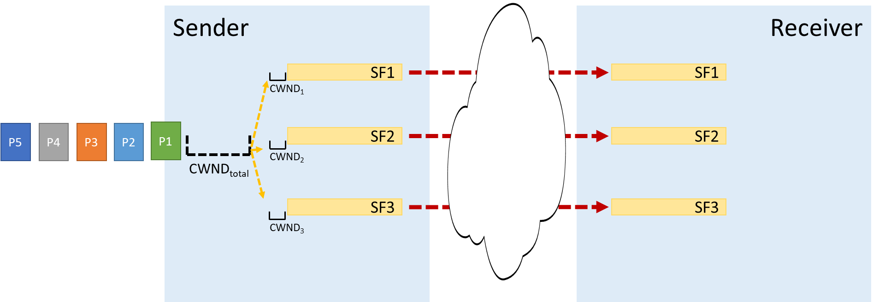
Motivation
Multi-path TCP
Multi-path Transport ?
TCP/IP
RDMA
The goal of this work is to design a high throughput and low latency multi-path transport for RDMA environment with low CPU overhead. (MP-RDMA)
Notes:
In TCP/IP network, some work extends TCP to multi-path TCP to solve the problem
In RDMA environment, there is no such a counterpart, our goal is to design such a transport

Slide 74
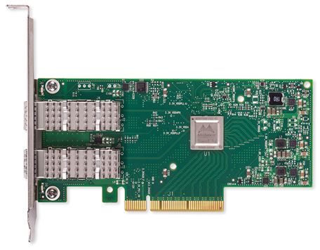
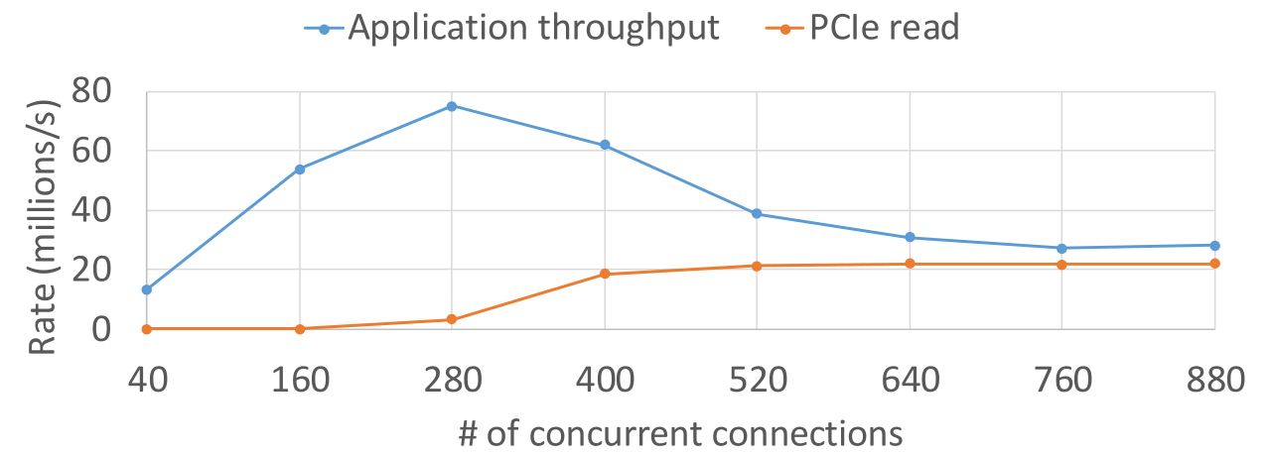
Uniqueness of RDMA Environment
NIC on-chip memory is scarce
Serves as a cache for RDMA connection states
Cache miss → host memory
PCIe latency becomes bottleneck
Frequent cache miss and results in poor performance
Host memory
Conn States
NIC
Receive data/ACK
MP-RDMA design needs to add as little hardware memory footprint as possible compared with existing single-path RDMA
Conn States
Conn States
Send out, no cache
…
Fetch through PCIe
Conn States

Slide 75
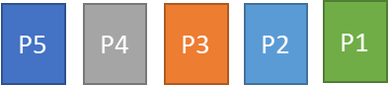
Challenges
#1: How to achieve congestion-aware traffic split without per-path states?
#2: How to track out-of-order packets with small on-chip memory footprint?
#3: How to provide message ordering without hurting the application performance?
Multi-path
congestion control
Keep original RDMA message semantics

Slide 76
Challenge #1
Tracking the transmission and congestion states on every paths
Congestion-aware load distribution
MPTCP transport maintains per-path states at host
RoCEv2: 248B per connection
8 paths requires 368 Bytes → more frequent cache miss
Each path requires states including rcv nxt, snd nxt, snd una, snd ssthresh, snd cwnd, srtt, rttvar, rtt seq, map data seq, map subseq, map data len, ...
Challenge #1:
How to do multi-path congestion control without per-path states?
Notes:
MPTCP: 1 cWnd, 1 SND.UNA, 1 SND.NXT, ssThreshold → 16 Bytes

Slide 77
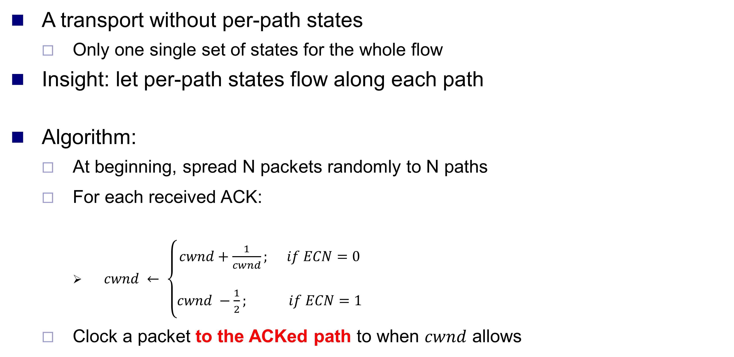
Multi-Path ACK Clocking
A transport without per-path states
Only one single set of states for the whole flow
Insight: let per-path states flow along each path
Algorithm:
At beginning, spread N packets randomly to N paths
For each received ACK:
$cwnd ← \left\{\begin{aligned}cwnd+\frac{1}{cwnd}; if ECN=0 \\ \\ cwnd −\frac{1}{2}; if ECN=1\end{aligned}\right.$
Clock a packet to the ACKed path to when $cwnd$ allows
“Good” paths load will gradually increase
“bad” paths load will decrease quickly

Slide 78
Multi-Path ACK Clocking
non-ECN, cwnd = 3.3, avail_wnd = 1.3(>1)
SEND
Non- ECN, cwnd = 3.1, avail_wnd = 2.1(>1)
SEND
4
1
1
2
2
6
5
3
3
ECN, cwnd = 2.8, avail_wnd = 0.8(<1)
NOT SEND
Data Packet
ACK Packet
avail_wnd = cwnd − (snd_nxt −snd_una)
initi_cwnd = 3, avail_wnd = 0

Slide 79
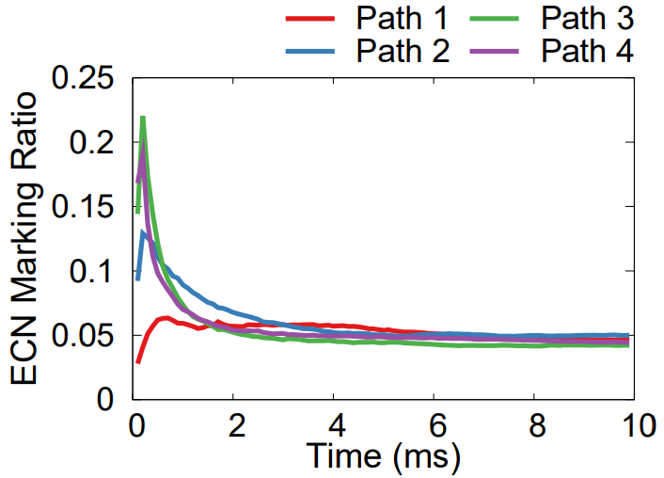
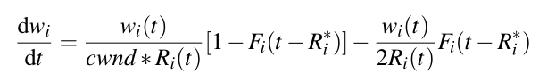
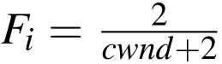
Multi-Path ACK Clocking
Fluid model
Cwnd of path i
ECN marking ratio of path i
RTT of path i
The ECN marking ratio on each path are equal!
MP-RDMA does congestion-aware load balance without maintaining per-path states on host

Slide 80
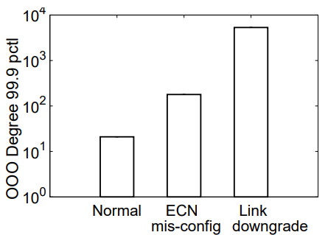
Challenge #2
Multi-path transmission → packets out-of-order at receiver
Need meta data to track out-of-order
Out-of-order degree depends on paths latency differences
Can be very large under certain scenarios
e.g. Link downgrade → 1.2KB bitmap
e.g. PFC pause → infinite
Keep original RDMA message semantics
Challenge #2:
How to track out-of-order packets with small on-chip memory footprint?

Slide 81
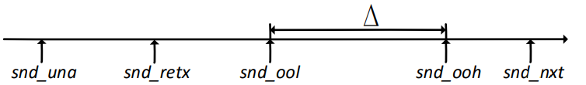
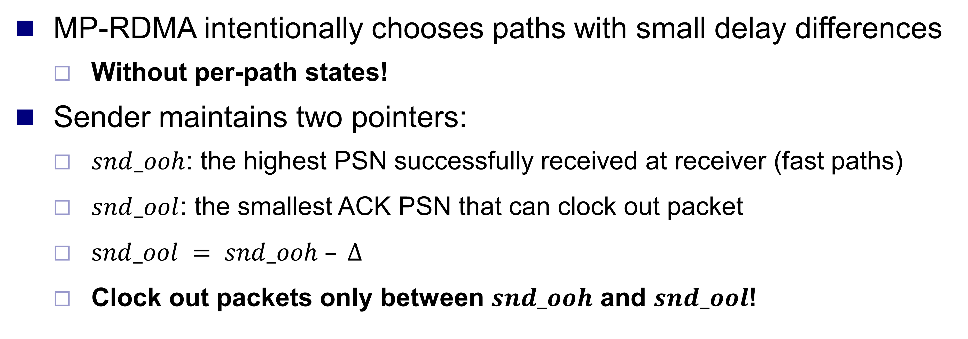
Out-of-order Aware Path Selection
MP-RDMA intentionally chooses paths with small delay differences
Without per-path states!
Sender maintains two pointers:
$snd_ooh$: the highest PSN successfully received at receiver (fast paths)
$snd_ool$: the smallest ACK PSN that can clock out packet
$snd_ool = snd_ooh – ∆$
Clock out packets only between $snd_ooh$ and $snd_ool$!
bad paths
good paths

Slide 82
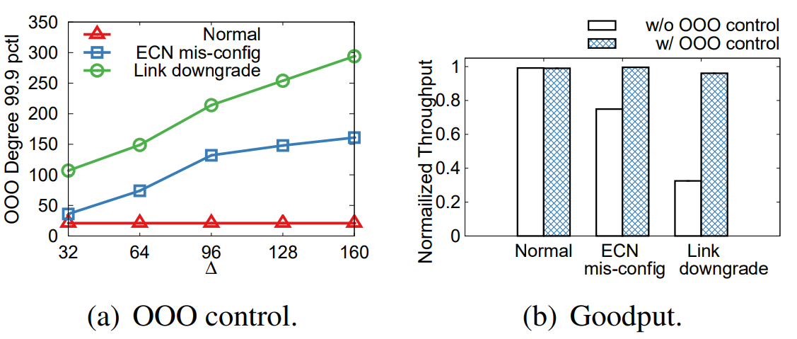
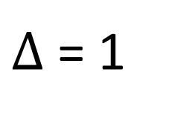
Fast
$∆$ = 1
0
1
2
3
4
Middle
Bitmap
MP-RDMA can track out-of-order with a tiny bitmap
3
3
1
1
1
2
4
2
5
1
1
1
2
3
SND.OOL
SND.OOL
SND.OOH
SND.OOH
Good path, SEND
Good path, SEND
Slow path, NOT SEND
Slow
Data Packet
ACK Packet

Slide 83
Challenge #3
Out-of-order data is directly placed to application buffer
Problem: application logic may assume messages in-order delivery
Naive solution: stop and wait
Throughput downgrade
Challenge #3:
How to provide message ordering without hurting the application performance?
Message 1
Message 2
Application poll on meta data
To check data completion
WRITE 1: Data
WRITE 2: meta data

Slide 84
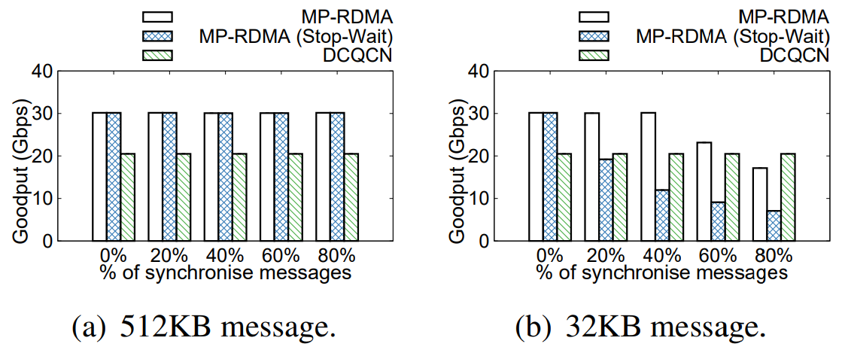
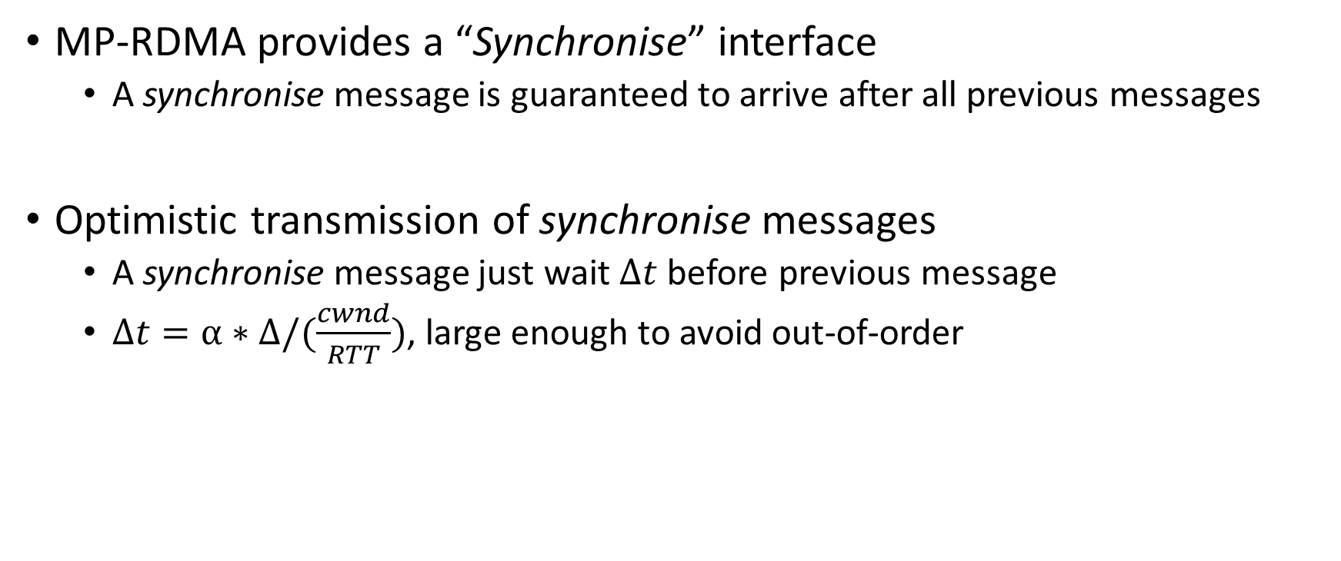
Synchronise mechanism
MP-RDMA provides a “Synchronise” interface
A synchronise message is guaranteed to arrive after all previous messages
Optimistic transmission of synchronise messages
A synchronise message just wait $∆t$ before previous message
$∆t=α∗∆/(\frac{cwnd}{RTT})$, large enough to avoid out-of-order
MP-RDMA synchronise mechanism can guarantee message ordering without sacrificing application throughput

Slide 85
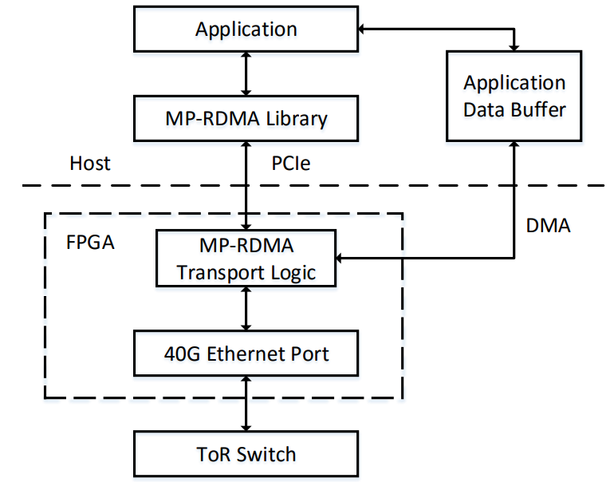
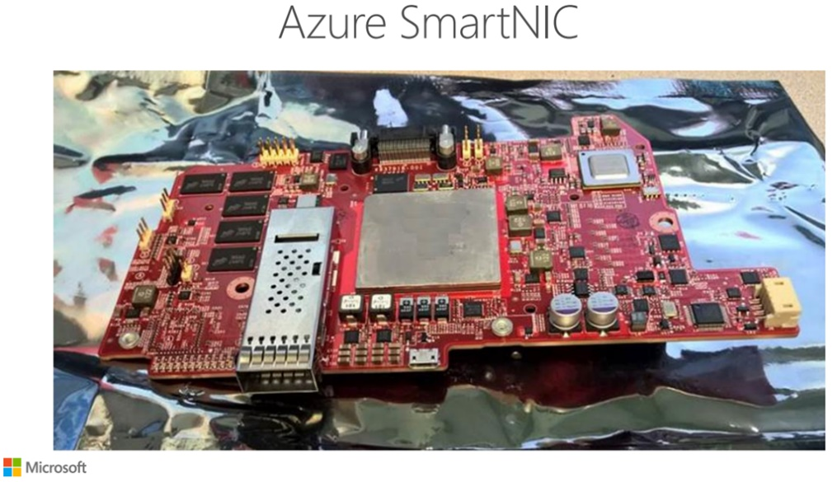
Implementation
A prototype is implemented in FPGA via ClickNP [4] platform
[4] Li, Bojie, et al. "ClickNP: Highly flexible and High-performance Network Processing with Reconfigurable Hardware." Proceedings of the 2016 conference on ACM SIGCOMM 2016 Conference. ACM, 2016.

Slide 86
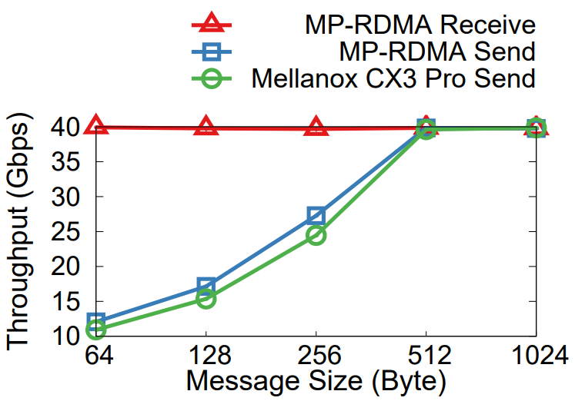
Basic benchmark of the MP-RDMA prototype
Receiving and Sending packet processing rates
Latency:
Send: 0.54us
Receive: 0.81us
States per connection:
69 Bytes
Conclusion:
MP-RDMA can be implemented in hardware with high performance

Slide 87
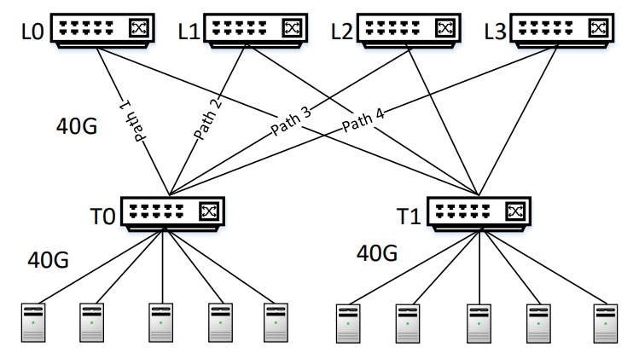
Testbed
10 FPGA boards

Slide 88
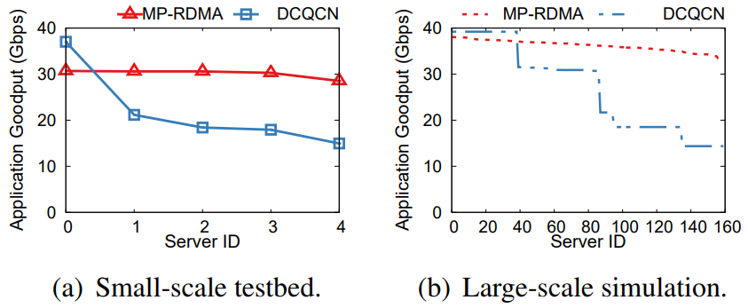
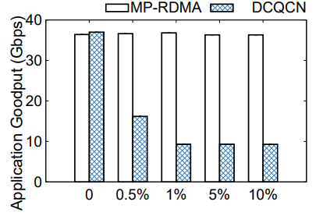
Key Results
Throughput: 47.05% higher application throughput v.s. DCQCN
More balanced among connections
Robust to failure: > 3x throughput improvement

Slide 89
MP-RDMA Recap
First effort to design a multi-path transport for RDMA environment
Minimize on-chip memory footprint
No per-path states
Out-of-order aware path selection
Synchronise mechanism to ensure message ordering
Improves throughput and robust to failure

Slide 90
Reading materials for group projects
“Data Center TCP (DCTCP)”, SIGOMM 2010
“Analysis of DCTCP: Stability, Convergence, and Fairness”, SIGMETRICS 2011
“Tuning ECN for Data Center Networks”, CoNEXT 2012
“Fast and Cautious: Leveraging Multi-path Diversity for Transport Loss Recovery in Data Centers”, USENIX ATC 2016
“Multi-Path Transport for RDMA in Datacenters”, NSDI 2018

Slide 91
Thanks!
陈果 副教授
湖南大学-信息科学与工程学院-计算机与科学系
邮箱：guochen@hnu.edu.cn
个人主页：1989chenguo.github.io

